Slide 1

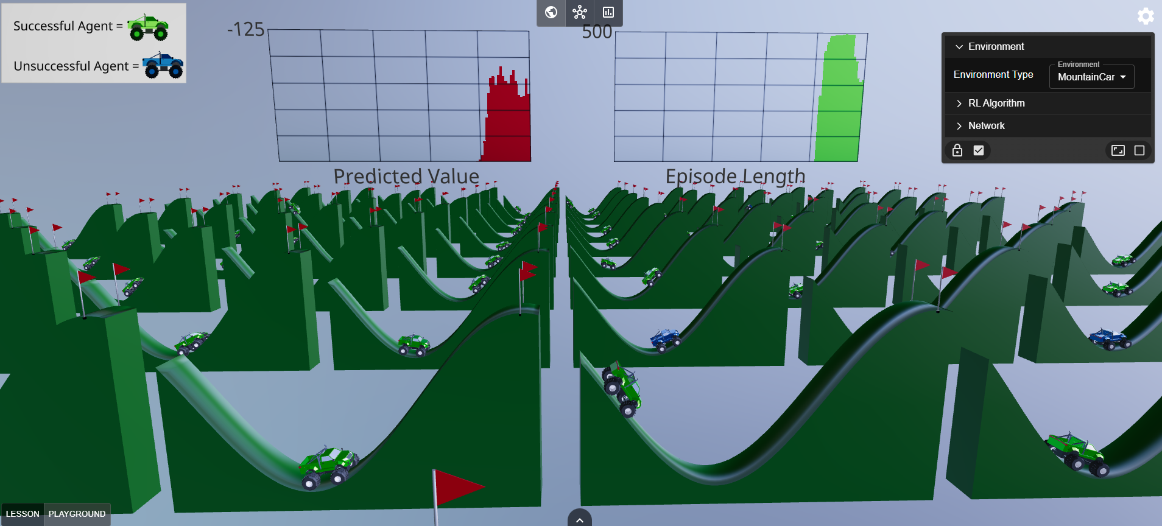




NeuRL: A Standalone No-Code Web-Based Agent Environment to Explore Neural Networks and Reinforcement Learning
By: Scott Siegel
https://neu-rl.netlify.app/

Slide 2

Immersive AI Education
The complexity of machine learning algorithms is a significant barrier to entry for non-experts
Passive forms of learning, such as slide shows and lectures, struggle to maintain learners attention¹
Immersive educational environments have stimulated a significant increase in declarative knowledge, engagement, and an interest in learning
Daghriri, I., Liang, C. J. & Huang, W. Spatial Immersive Learning Environments in Primary Education: A Review of Impacts and Implementation Challenges. in Proceedings of the 2024 International Conference on Information Technology, Data Science, and Optimization 99–105 (2024).
Sandoval-Henríquez, F. J., Sáez-Delgado, F. & Badilla-Quintana, M. G. Systematic review on the integration of immersive technologies to improve learning in primary education. Journal of Computers in Education 1–26 (2024).

Slide 3
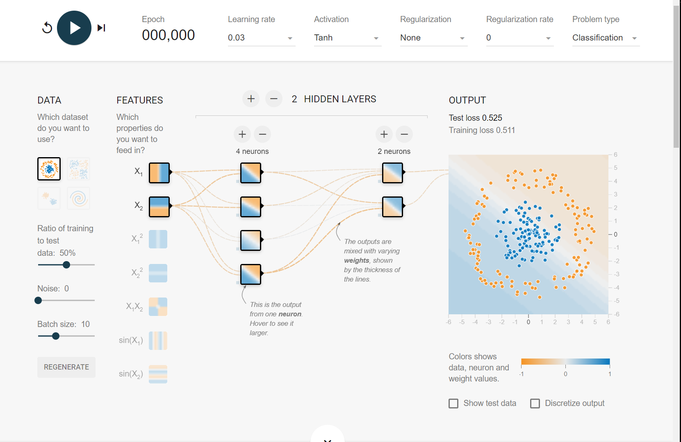
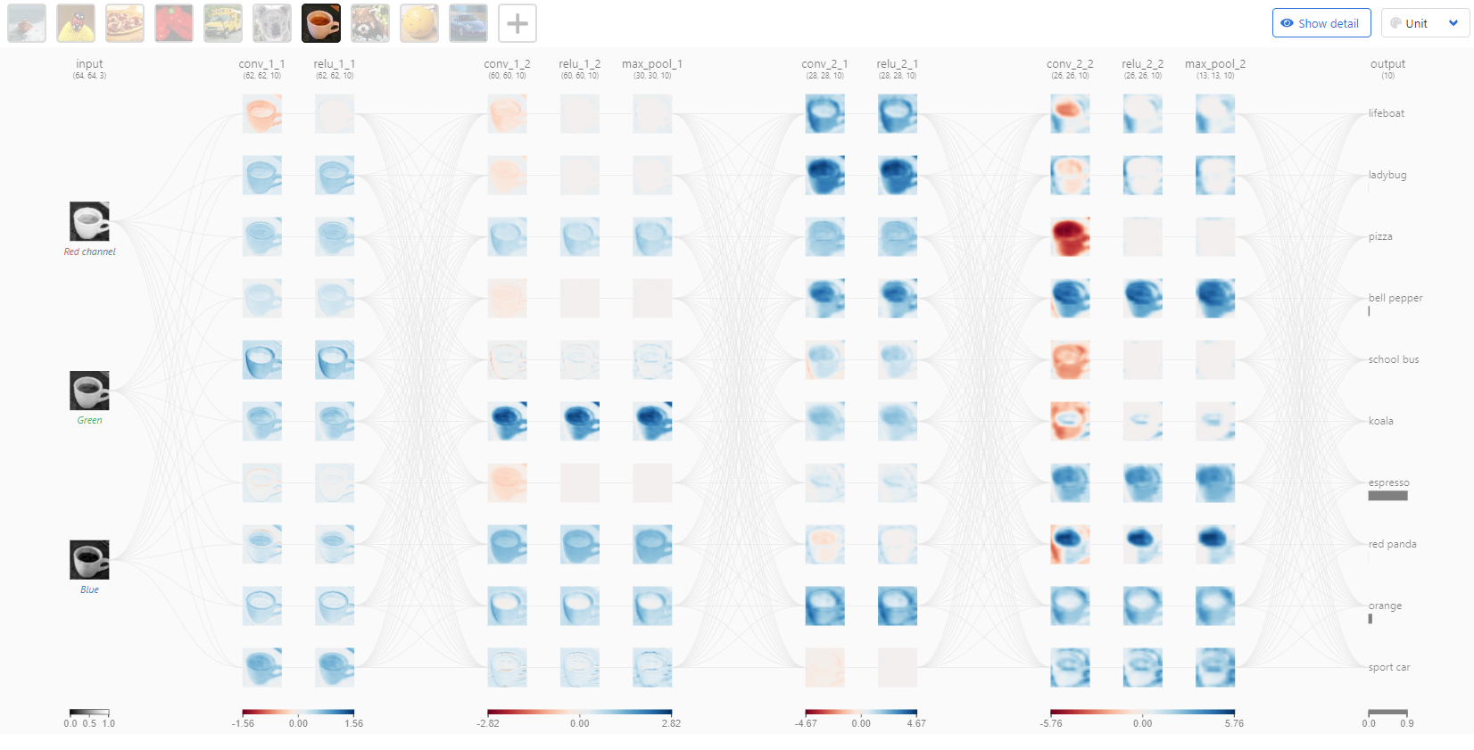
Web-based Tools for AI Education
Free web-based educational resources make AI education more accessible
Removes the need to download and install deep-learning libraries
Provide a wide range of libraries for visualization
Compatible with all operating systems that support modern web browsers
Carter, D. S. and S. Tensorflow — Neural Network Playground. http://playground.tensorflow.org.
Wang, Z. J. et al. CNN explainer: learning convolutional neural networks with interactive visualization. IEEE Transactions on Visualization and Computer Graphics 27, 1396–1406 (2020).

Slide 4
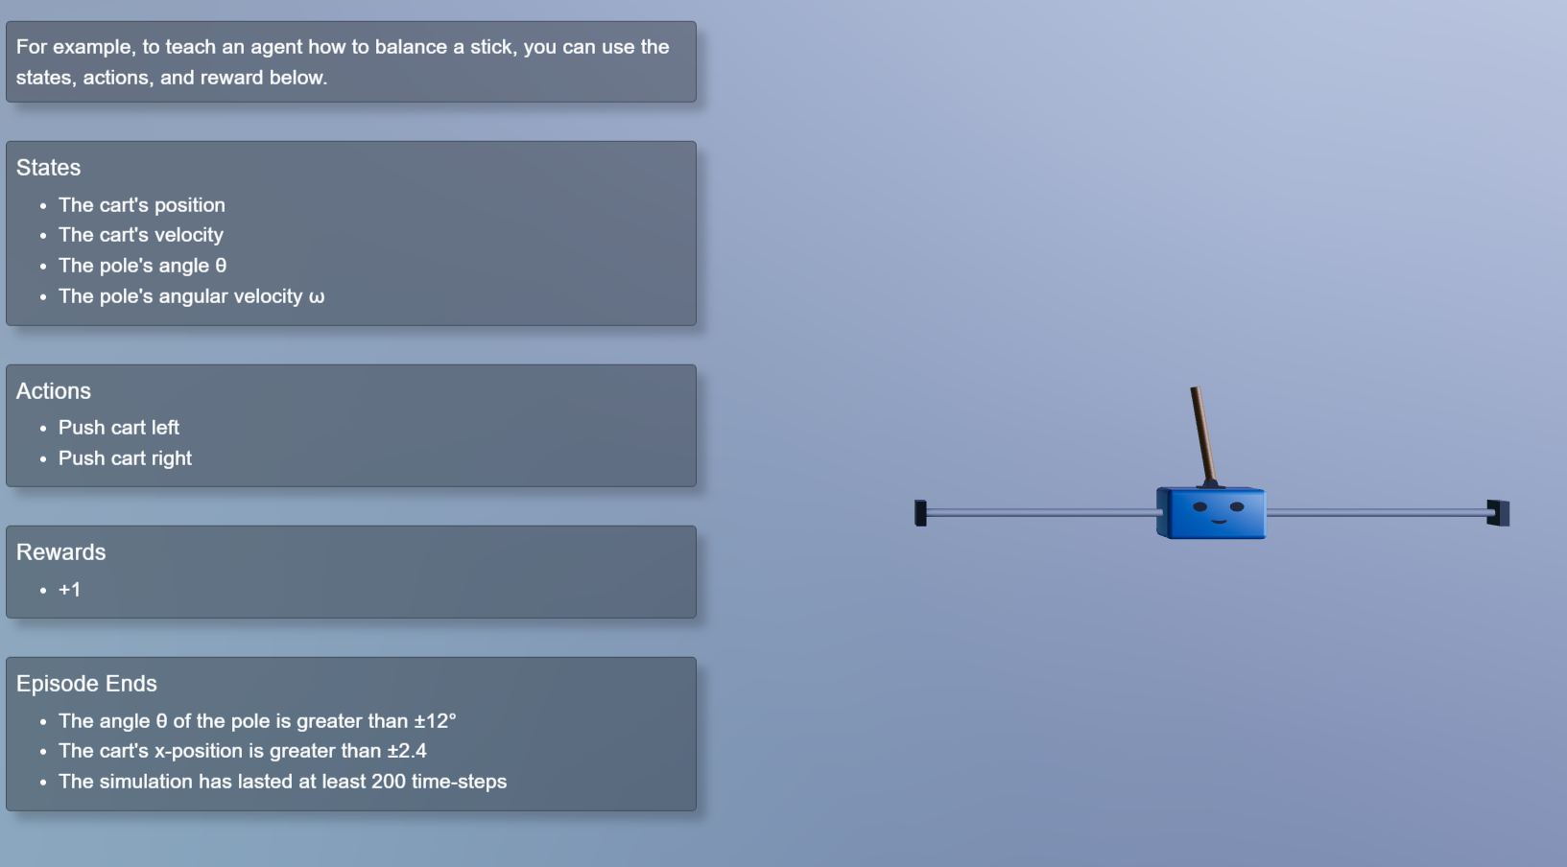
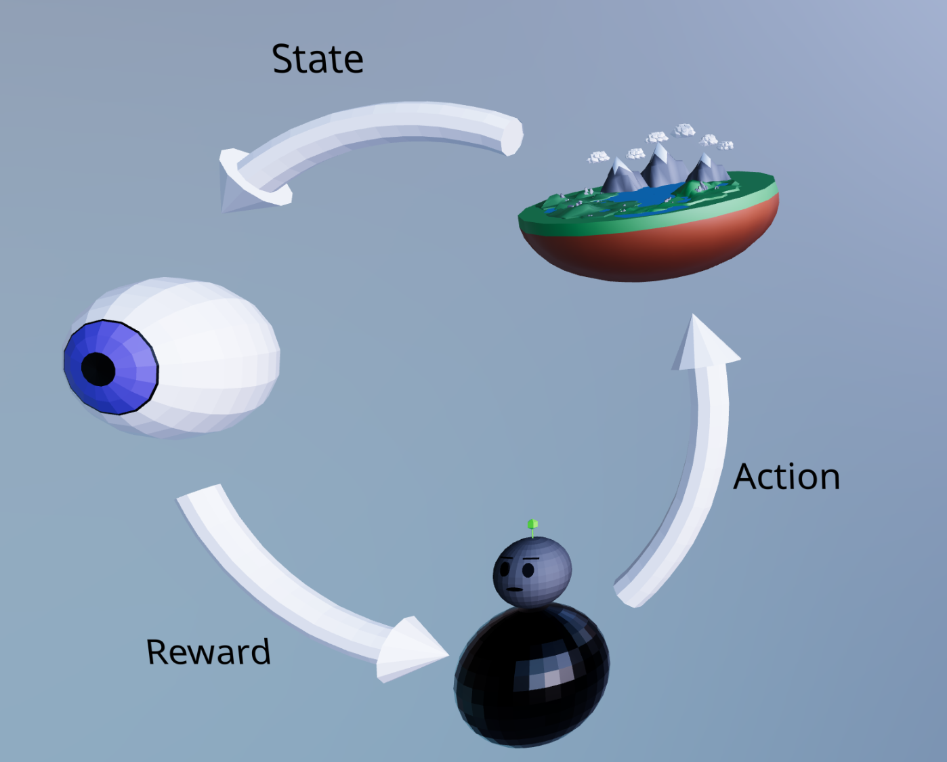
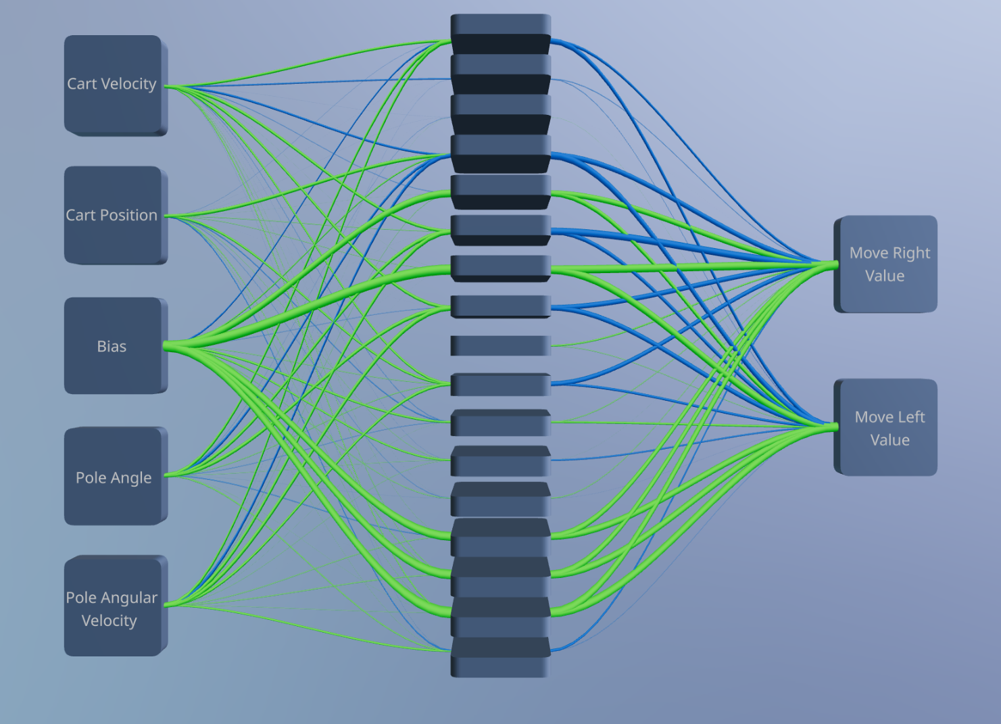
Reinforcement Learning
One of the three primary subtypes of machine learning
Used to teach autonomous agents how to perform tasks
Agents are taught to take actions that are deemed most valuable

Slide 5
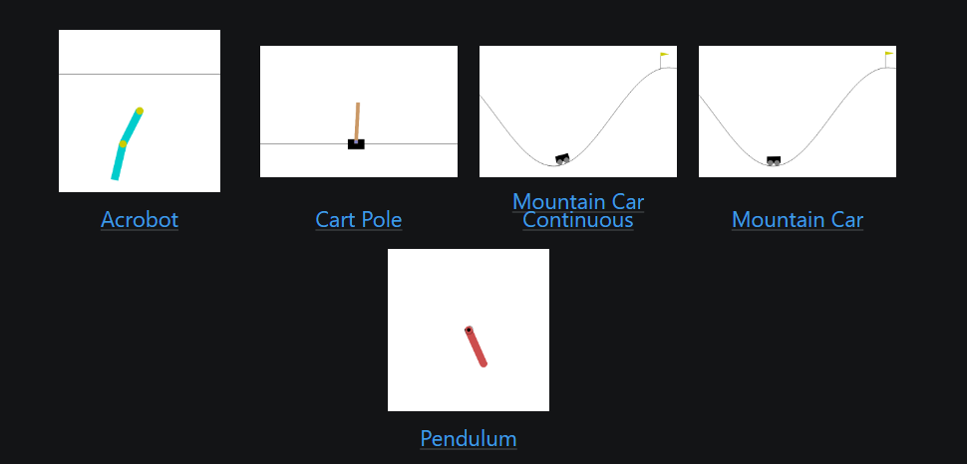
Gymnasium
Pros
Provides a flexible approach to explore reinforcement learning
Provides a wide range of environments
Enables easy benchmarking and comparison of different reinforcement learning algorithms
Cons
Requires installing multiple libraries
Requires coding understanding
Limited visualization tools
1. Contributors, G. Gymnasium: A toolkit for developing and comparing reinforcement learning algorithms. (2024).

Slide 6
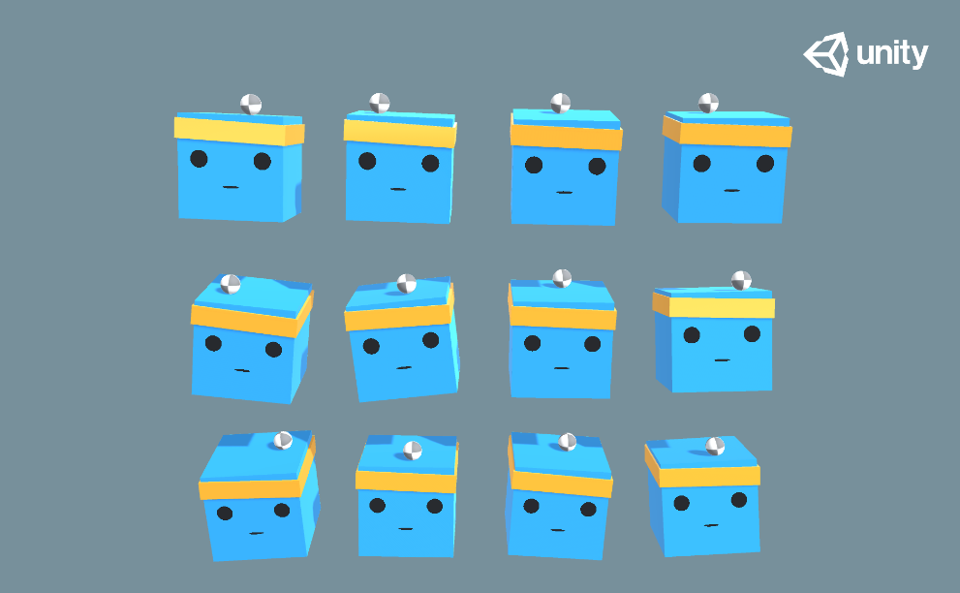
ML-Agents
Pros
Built on the Unity game engine¹ and PyTorch²
Provides over 17 environments to experiment with reinforcement learning
Cons
Requires a lengthy installation and setup process
Modifying environments and experimental setups is challenging
Running some of the environments requires powerful hardware
Juliani, A. et al. Unity: A general platform for intelligent agents. arXiv preprint arXiv:1809.02627 (2018).
Paszke, A. et al. PyTorch: An Imperative Style, High-Performance Deep Learning Library. Advances in Neural Information Processing Systems 32 8024–8035 Curran Associates, Inc. (2019).

Slide 7
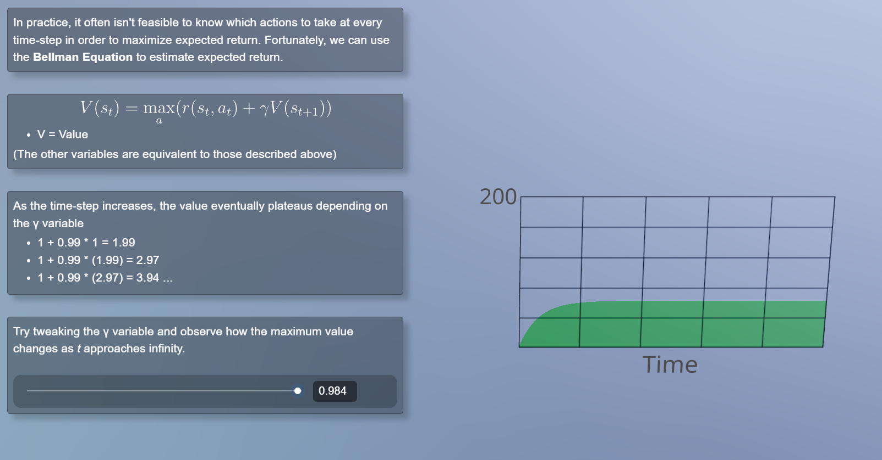
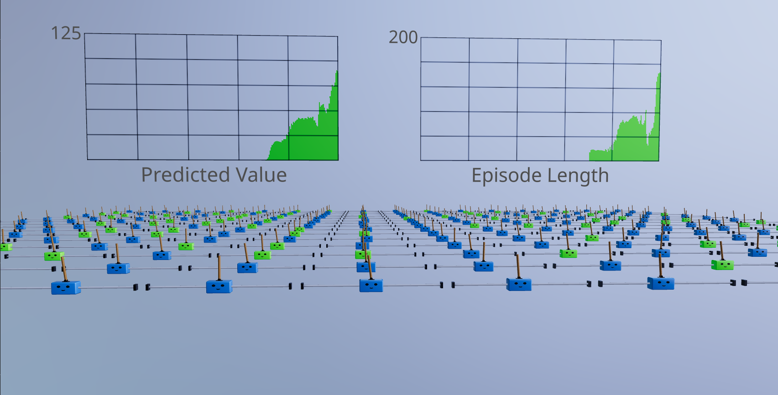
Introducing NeuRL
NeuRL provides:
3D WebGL environments that teach the fundamentals of neural networks and reinforcement learning
Real-time visualizations of agent behaviors and neural networks
Interactive no-code UI tools to experiment with different hyperparameters and reinforcement learning algorithms

Slide 8
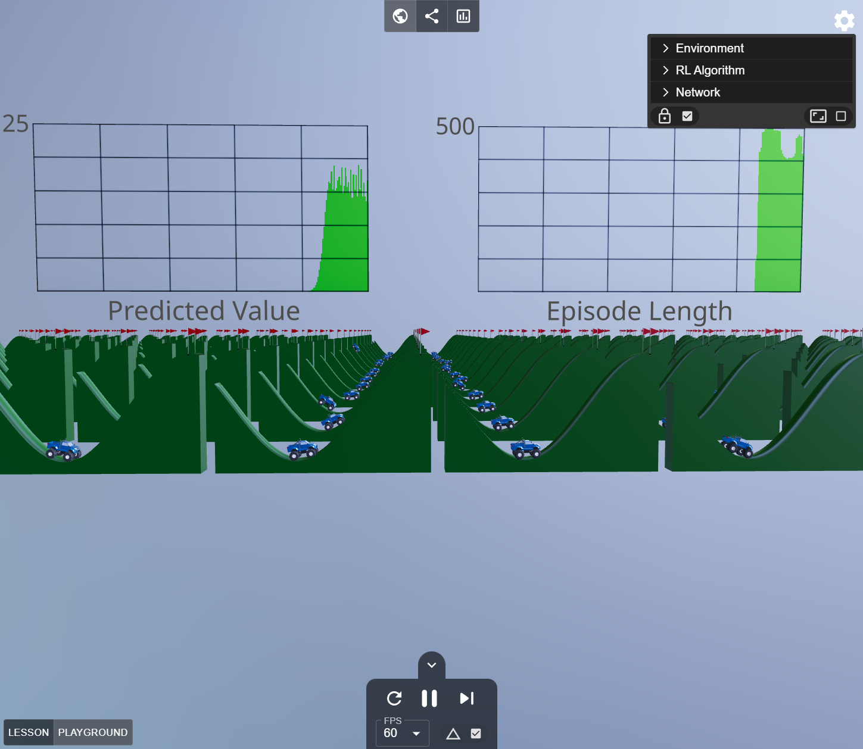
NeuRL’s Contributions
NeuRL is the first RL app to:
Run in web browsers as a static app, ensuring cost-free scaling compatibility with common operating systems
Run on mobile devices
Enable visualizing 3D agents and neural networks during every step of the simulation
Provide a completely no-code experience

Slide 9
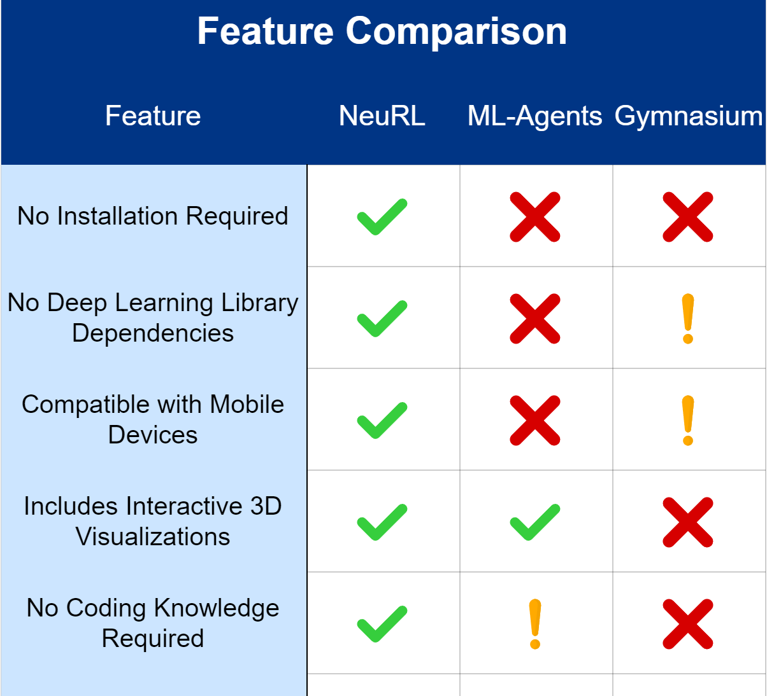
Comparisons with other RL Libraries

Slide 10
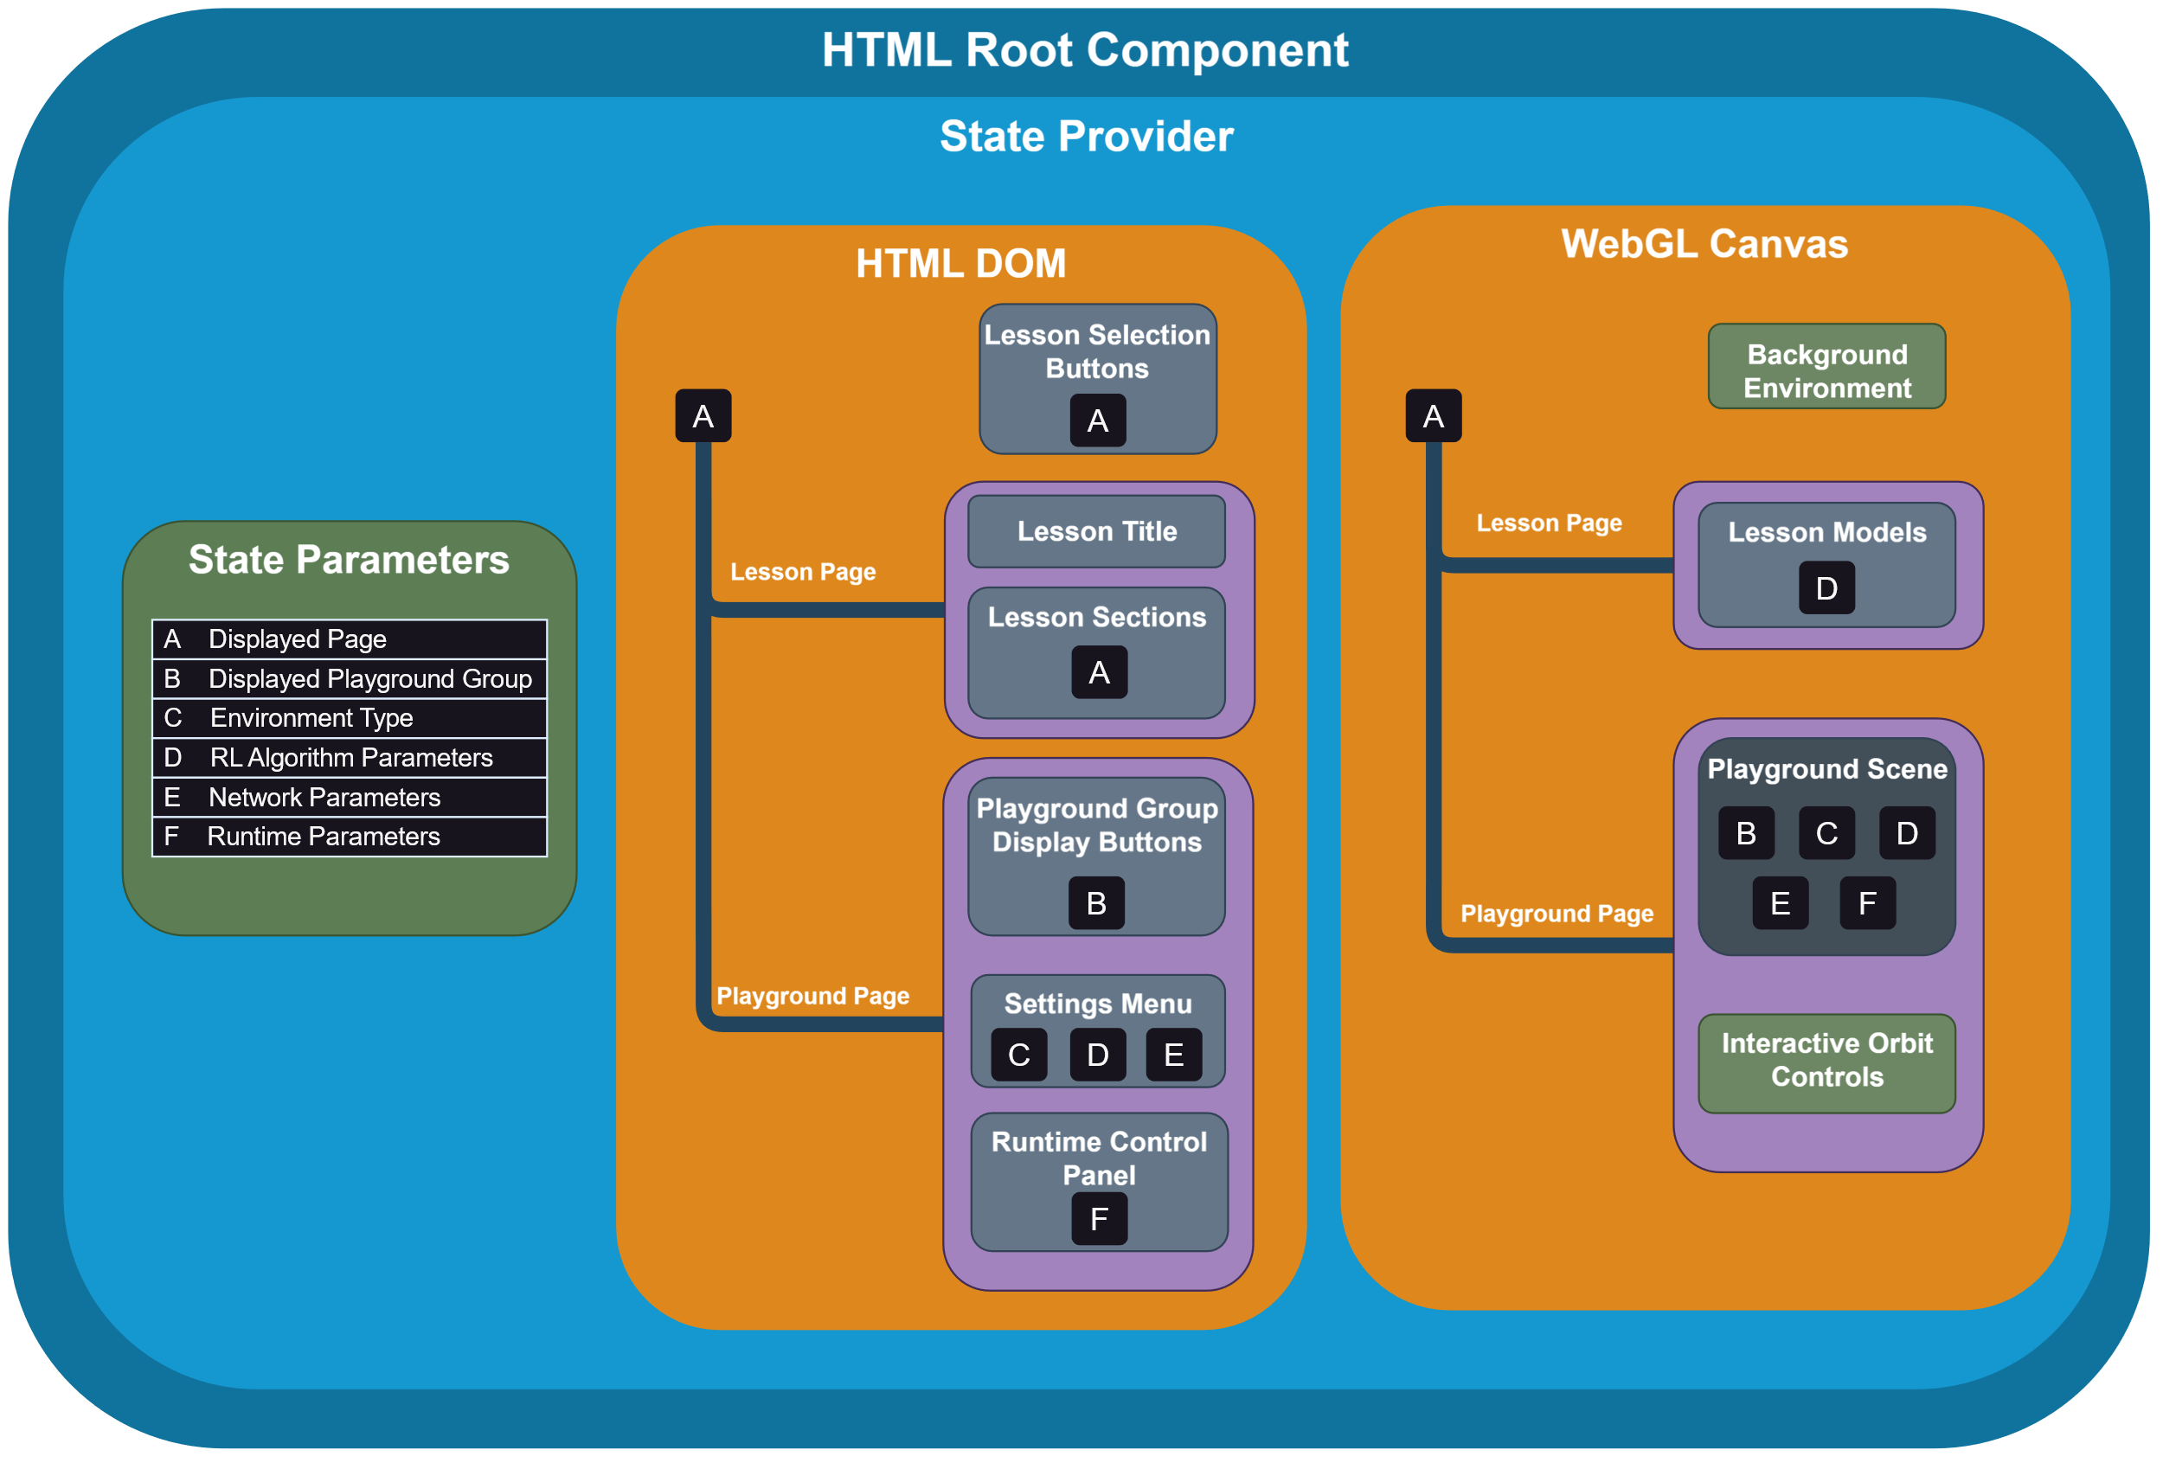
NeuRL’s Component Architecture

Slide 11
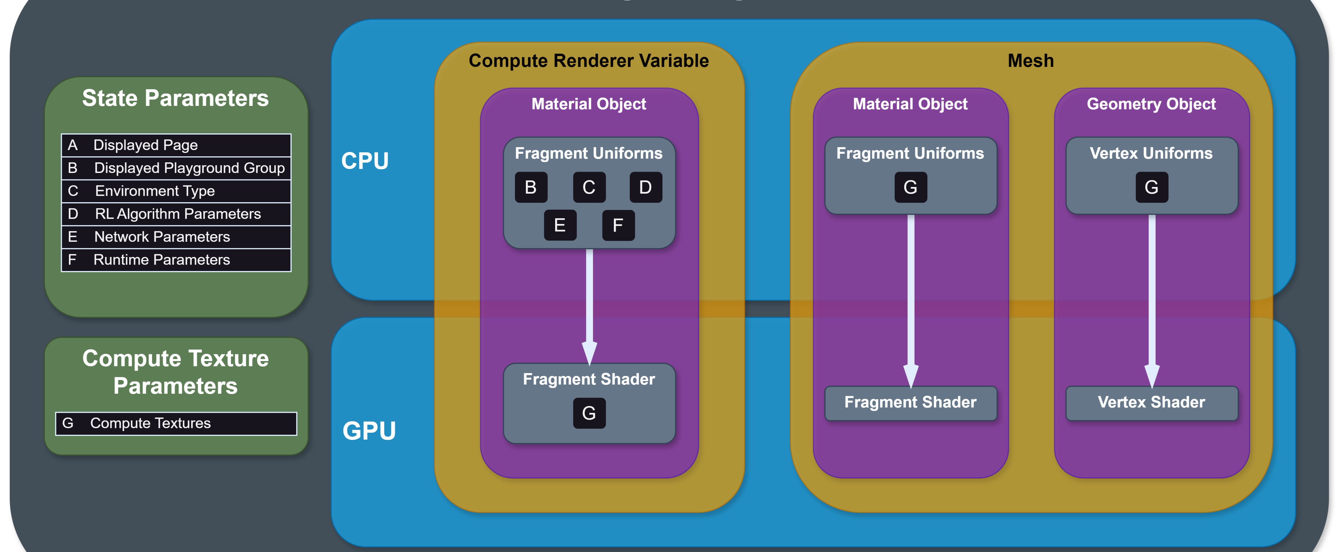
Interfacing Meshes with NeuRL’s Compute Texture Library

Slide 12
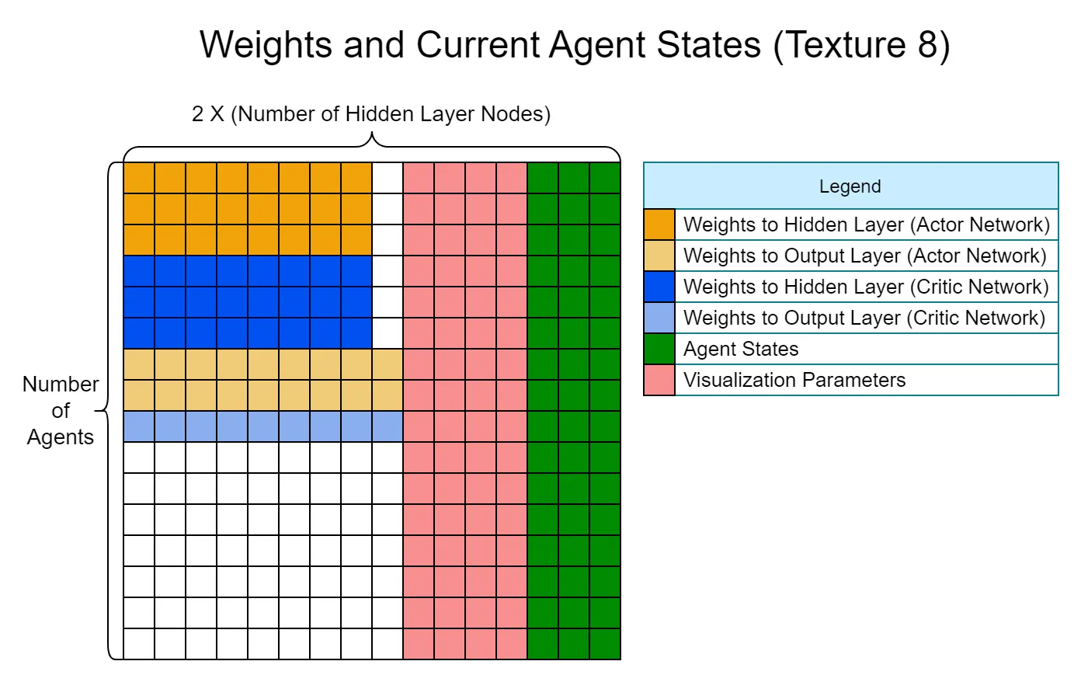
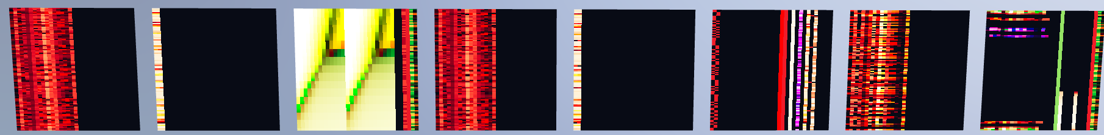
NeuRL’s Neural Network and Reinforcement Learning Library

Slide 13
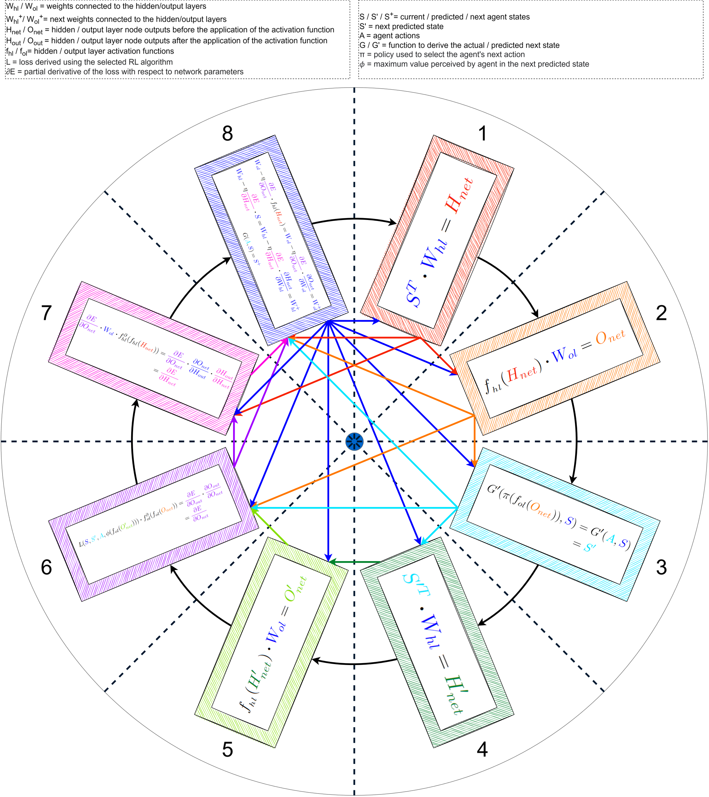
Information Flow Between Compute Shaders

Slide 14
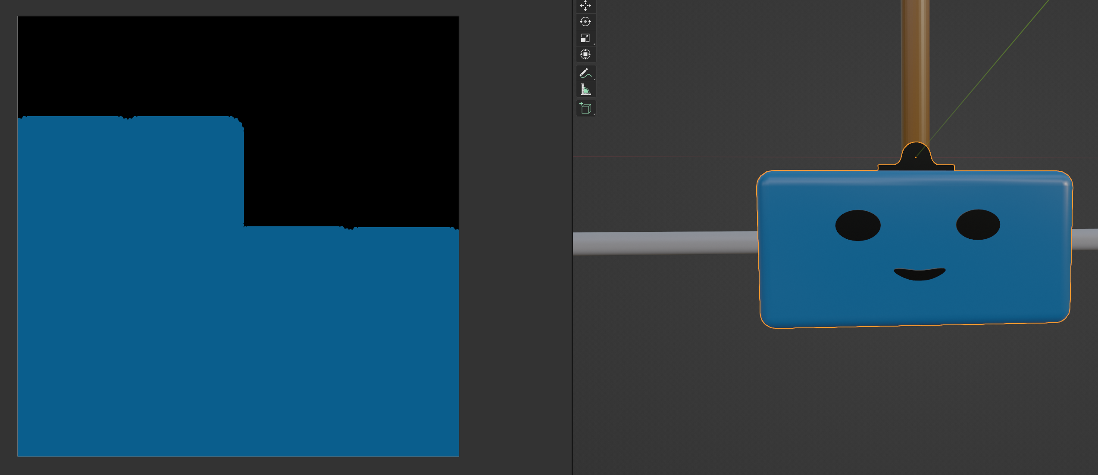
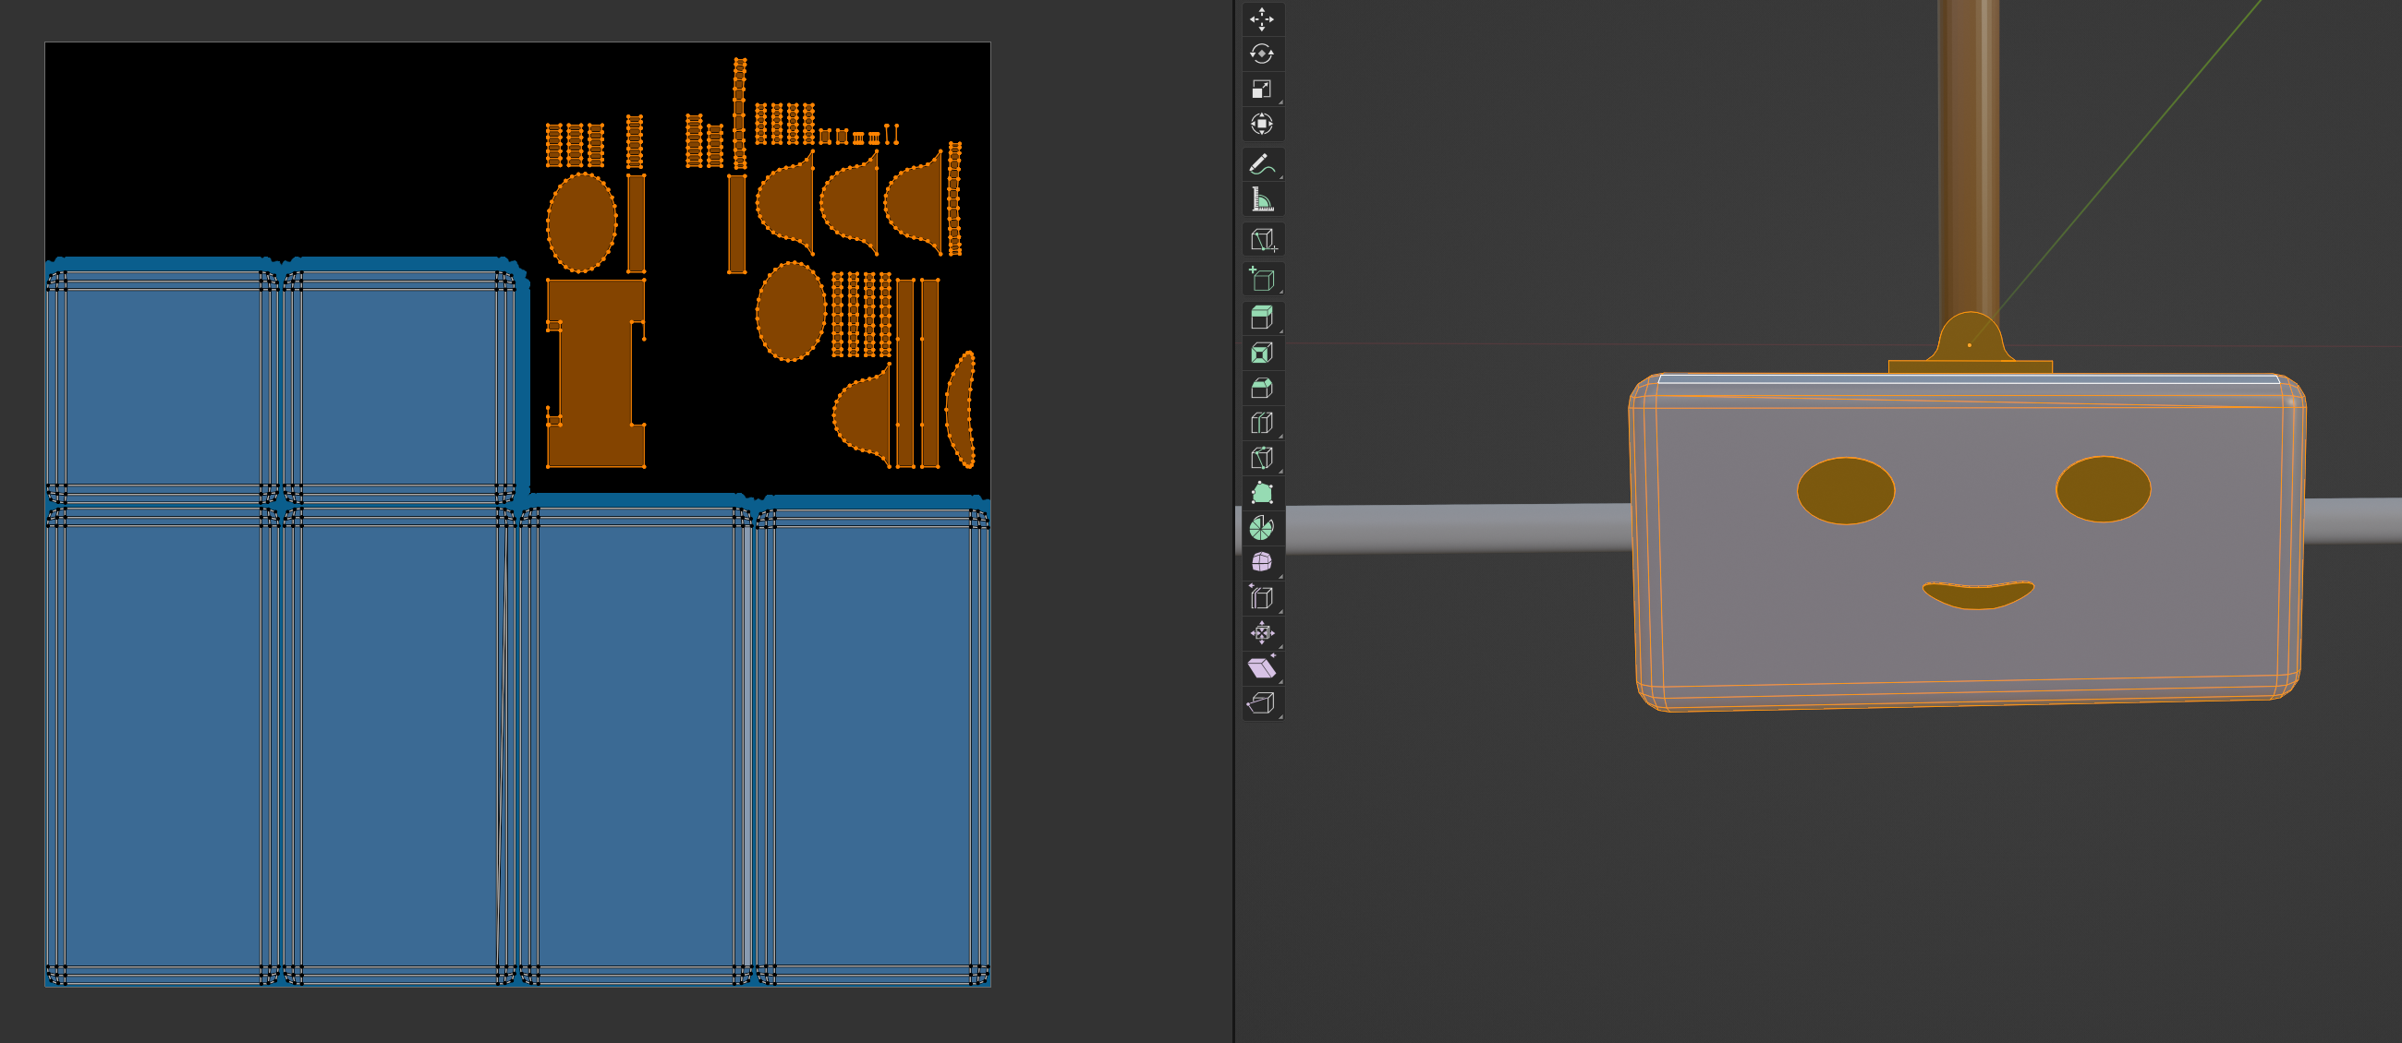
Mesh Design
Meshes were created in Blender
Meshes with multiple materials were combined using baked texture maps
Object dimensions followed the source-code provided by OpenAI’s Gymnasium library
Instancing used to render hundreds of meshes with a single draw call

Slide 15
Classroom Study
Demographics | N | %
Age (Years)
Under 18 | 1 | 1
18-24 | 69 | 72
25-34 | 23 | 24
35-44 | 2 | 2
44+ | 1 | 1
Gender
Male | 71 | 74
Female | 23 | 24
No Response | 2 | 2
Major
Computer Science | 88 | 92
Computer Engineering | 6 | 6
Other | 2 | 2
Degree Program
Undergraduate | 33 | 34
Graduate | 63 | 66
During the lecture, students were asked to do the following
Control the cart agent and see if they could balance the pole
Modify the gamma parameter and see if they can get the value predicted by the Bellman equation equal to 10
Adjust the gamma and neural network learning rate hyperparameters and compete to see who can successfully train the agents with the lowest gamma value

Slide 16
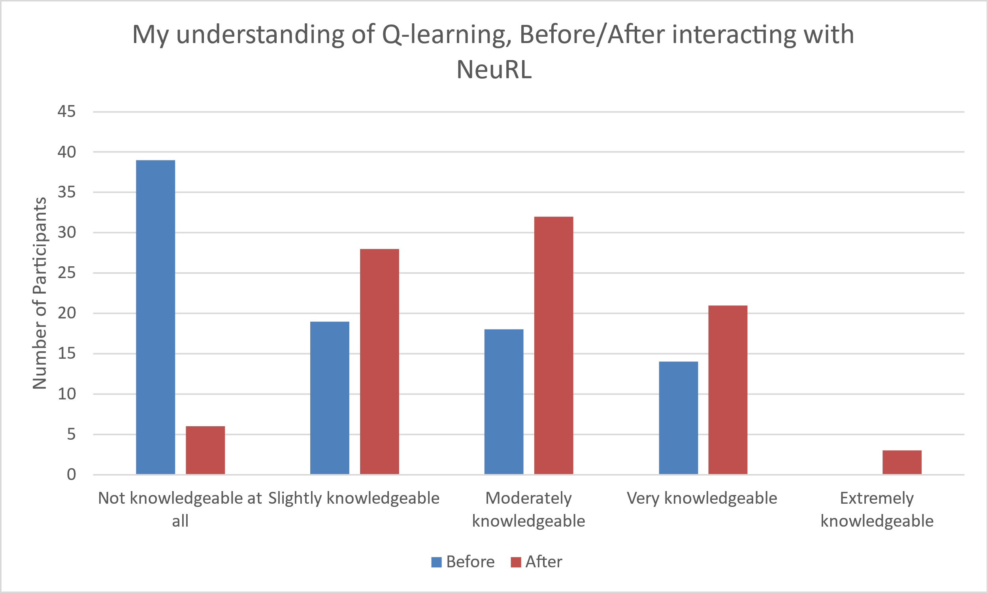
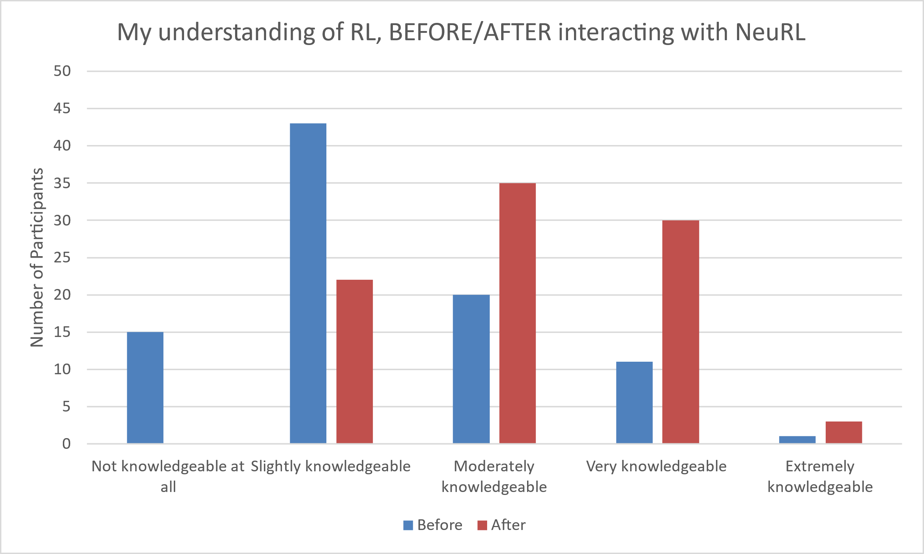
Study Results – Learning Outcomes
Students felt that interacting with NeuRL improved their understanding of reinforcement learning and Q-learning

Slide 17
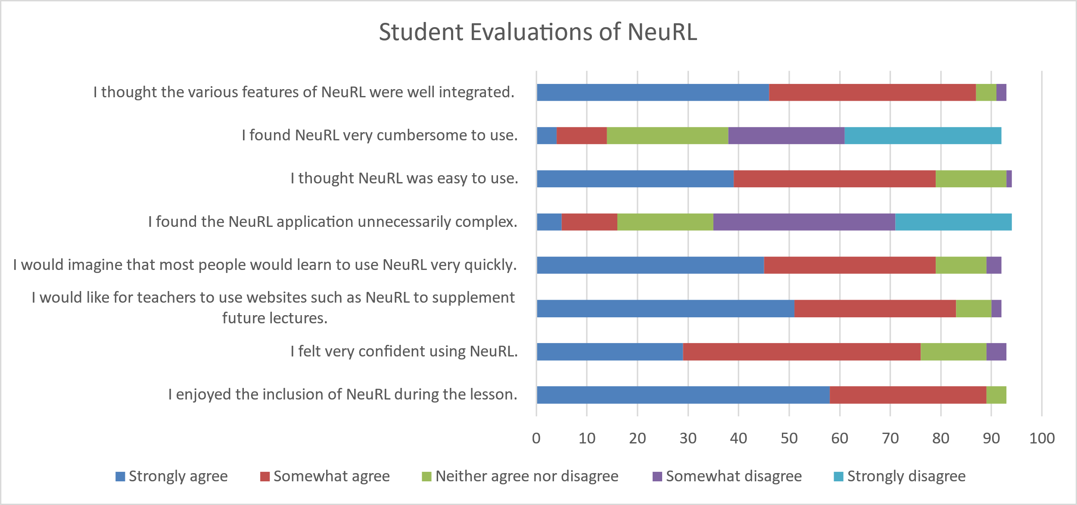
Study Results – Usability
Students found NeuRL easy to use and felt confident when using NeuRL

Slide 18
Future Directions
Add more topics and expand NeuRL into a comprehensive AI education platform
1
Collaborate with educational institutions to integrate NeuRL into their curriculum
3
Add compatibility with VR and AR setups
5
Create analytics suite to track user activities and measure learning outcomes
4
Integrate NeuRL with a cloud-based chatbot
2

Slide 19
Acknowledgements
Authors:
Amanpreet Kapoor
Parisa Rashid
Special thanks to:
Vincent Bindschaedler
Subhash Nerella
https://neu-rl.netlify.app/

